Slide 1
Electrical-vehicle Population
Analysis

Slide 2
Introduction:
The dataset provides a comprehensive overview of electric vehicles (EVs) registered within a specific region or country. this dataset encompasses various attributes, including vehicle make, model, year of manufacture, electric range, and geographical distribution. Analyzing this dataset offers valuable insights into EV adoption trends, consumer preferences, and the geographical distribution of electric vehicles.

Slide 3
Objectives:
Analyze trends in electric vehicle adoption over time (year-wise).
Explore variations in electric vehicle sales based on vehicle make and model.
Investigate the distribution of electric vehicles across different cities and regions.
Identify patterns and preferences in electric vehicle ownership by analyzing demographic factors.
Gain insights into the market share of different electric vehicle manufacturers.
Assess the impact of incentives and eligibility criteria on the adoption of clean alternative fuel vehicles.
Provide actionable insights for policymakers, automotive manufacturers, and stakeholders involved in promoting sustainable transportation solutions.

Slide 4
Content:
County: The county where the vehicle is registered.
City: The city where the vehicle is registered.
State: The state where the vehicle is registered.
Postal Code: The postal code of the registration location.
Model Year: The year the vehicle model was manufactured.
Make: The manufacturer or brand of the vehicle.
Model: The specific model of the vehicle.
Electric Vehicle Type: Type of electric vehicle (e.g., Battery Electric Vehicle (BEV), Plug-in Hybrid Electric Vehicle (PHEV), etc.).
Clean Alternative Fuel Vehicle (CAFV) Eligibility: Indicates if the vehicle is eligible for Clean Alternative Fuel Vehicle incentives or programs.
Electric Range: The range of the electric vehicle on a full charge.
Base MSRP: Manufacturer's Suggested Retail Price (MSRP) for the vehicle.
Legislative District: The legislative district associated with the vehicle's registration.
DOL Vehicle ID: Department of Licensing Vehicle ID.
Vehicle Location: The location where the vehicle is currently located.
Electric Utility: The electric utility provider associated with the vehicle's registration.
2020 Census Tract: Census tract information for the vehicle's registration location.

Slide 5
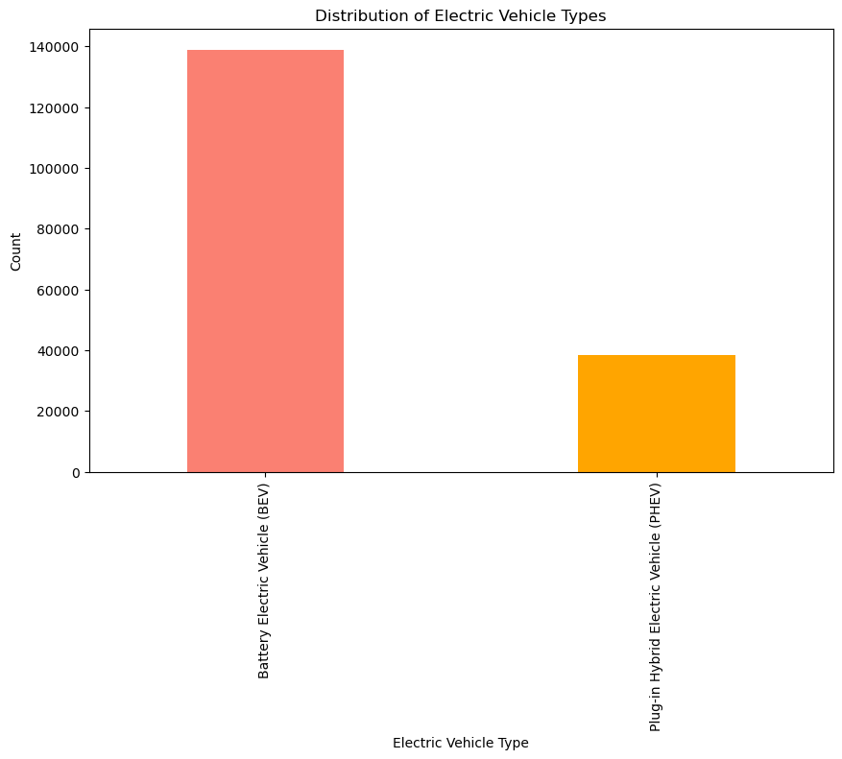
1)Distribution of electric vehicle types
Electric Vehicle Type:
Battery Electric Vehicle (BEV) 138947
Plug-in Hybrid Electric Vehicle (PHEV) 38526
There are two types of vehicle Battery Electric Vehicles (BEVs) and Plug-in Hybrid Electric Vehicles (PHEVs). Among the registered electric vehicles, BEVs represent the predominant category, comprising approximately 138,947 units, while Plug-in Hybrid Electric Vehicles (PHEVs) account for a smaller yet significant portion with approximately 38,526 units.

Slide 6
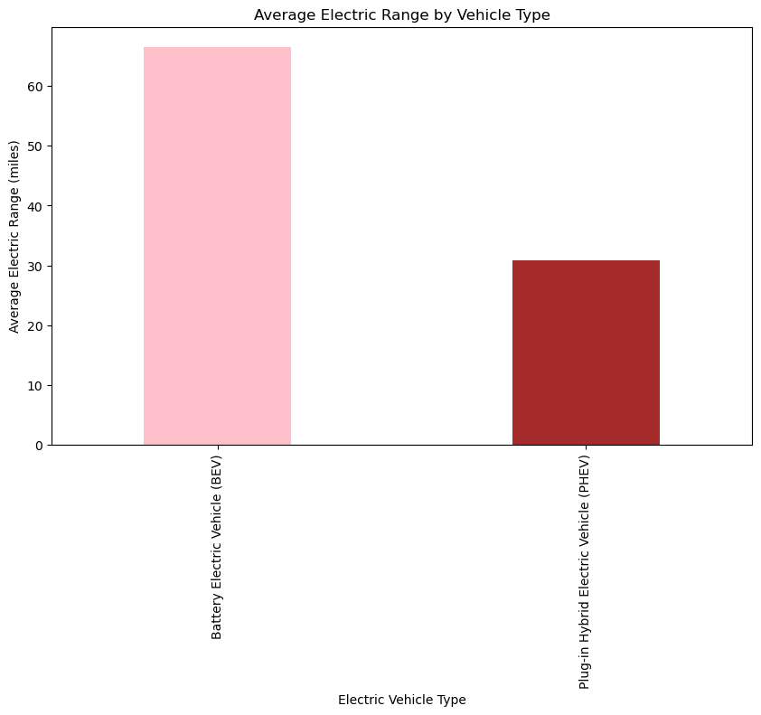
2)Variation of electric range across different vehicle types
Electric Vehicle Type
Battery Electric Vehicle (BEV) 66.594536
Plug-in Hybrid Electric Vehicle (PHEV) 30.810699
Battery Electric Vehicles (BEVs) demonstrate a substantially higher average electric range of approximately 66.59 miles.
Plug-in Hybrid Electric Vehicles (PHEVs) exhibit a lower average electric range of around 30.81 miles.

Slide 7
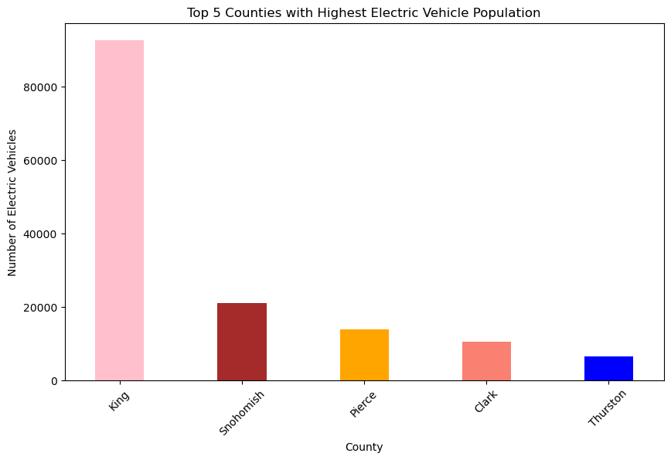
3)Top 5 Counties with the Highest Electric Vehicle Population
County
King 92740
Snohomish 21001
Pierce 13782
Clark 10409
Thurston 6428
Conclusion:
King County leads with the highest electric vehicle population at 92,740, while Thurston County lags behind with the lowest count at 6,428, highlighting disparities in electric vehicle adoption across counties.

Slide 8
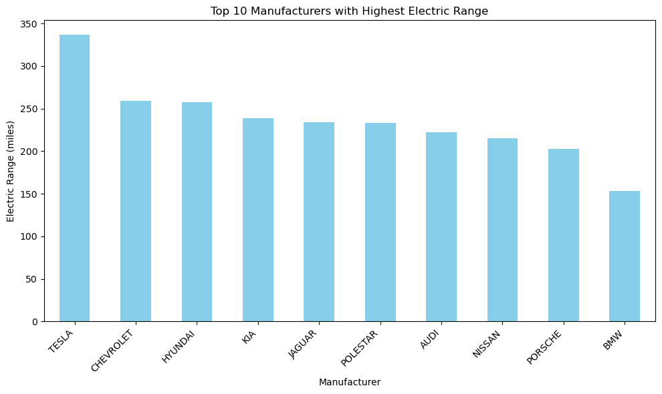
4)Top 10 manufacturers with the highest electric range
Top 10 manufacturers with the highest electric range:
TESLA 337
CHEVROLET 259
HYUNDAI 258
KIA 239
JAGUAR 234
POLESTAR 233
AUDI 222
NISSAN 215
PORSCHE 203
BMW 153
Conclusion: Tesla leads with the highest electric range among manufacturers. BMW ranks lowest among the top 10 manufacturers, indicating variations in electric vehicle capabilities across brands.

Slide 9
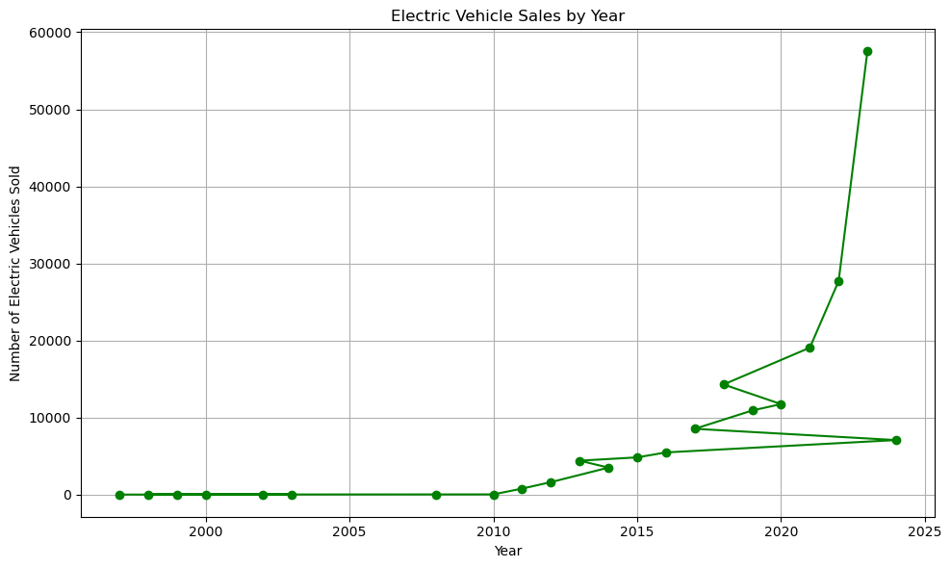
5)find out Electric Vehicle Sales by Year
The highest number of electric vehicle sales occurred in the year 2023, with a total of 57,519 vehicles sold.
The lowest number of electric vehicle sales was recorded in the years 1997, 1998, 1999, 2000, 2002, and 2003, with each year having only 1 to 7 vehicles sold.

Slide 10
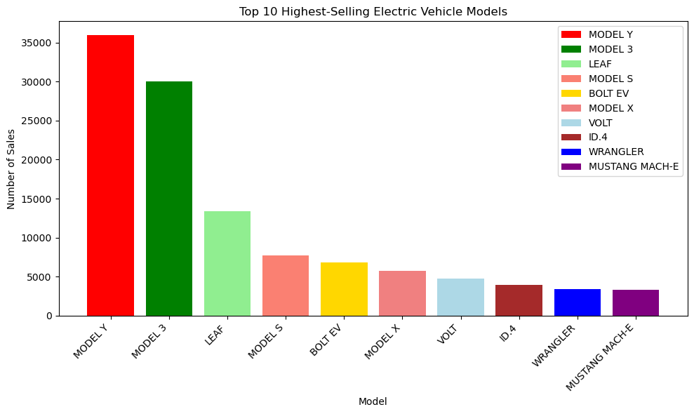
6)find out Top 10 Highest-Selling Electric Vehicle Models
Conclusion:
The Model Y is the highest-selling electric vehicle model, with 35,921 units sold.
Following closely behind is the Model 3, with 30,009 units sold.
The Leaf takes the third position with 13,352 units sold.

Slide 11
7)What are the unique makes present in battery electric vehicles (BEVs), and how many different makes are there in total?
Makes in Battery Electric Vehicles:
Total : 31
['TESLA' 'NISSAN' 'CHEVROLET' 'AUDI' 'KIA' 'SMART' 'VOLKSWAGEN' 'RIVIAN'
'TOYOTA' 'HYUNDAI' 'FIAT' 'FORD' 'VOLVO' 'MERCEDES-BENZ' 'SUBARU' 'BMW'
'JAGUAR' 'POLESTAR' 'PORSCHE' 'MINI' 'LUCID' 'MITSUBISHI' 'CADILLAC'
'FISKER' 'LEXUS' 'GENESIS' 'TH!NK' 'GMC' 'MAZDA' 'AZURE DYNAMICS'
'ROLLS ROYCE’]

Slide 12
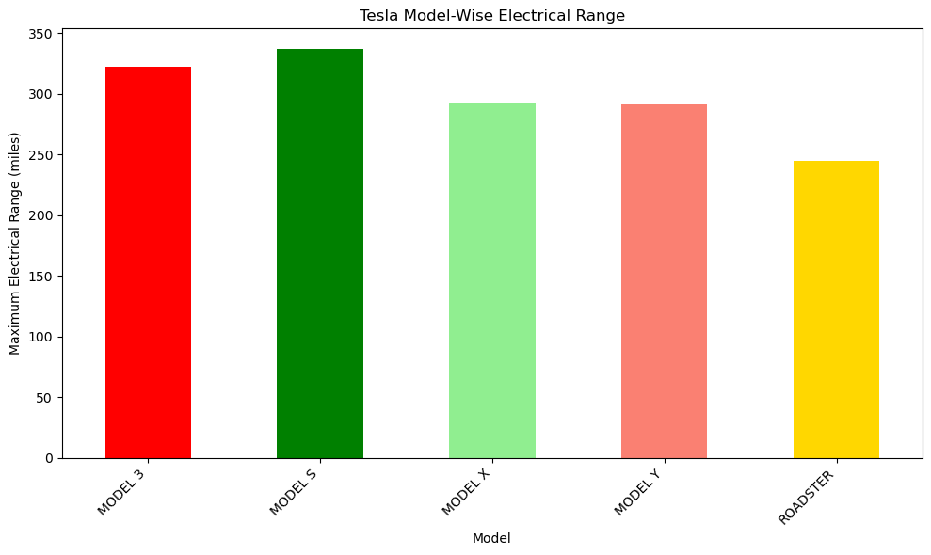
8)What is the maximum electrical range of each Tesla model, and how does it vary across different Tesla models?
Conclusion:
The Model S has the highest maximum electrical range among Tesla models, with a range of 337 miles.
It is followed by Model 3 with a maximum range of 322 miles, showcasing its efficiency and performance.
The Model X and Model Y have slightly lower ranges compared to the Model S and Model 3, with ranges of 293 miles and 291 miles, respectively.
The Roadster, although having a lower range compared to other Tesla models, still offers a respectable maximum range of 245 miles.

Slide 13
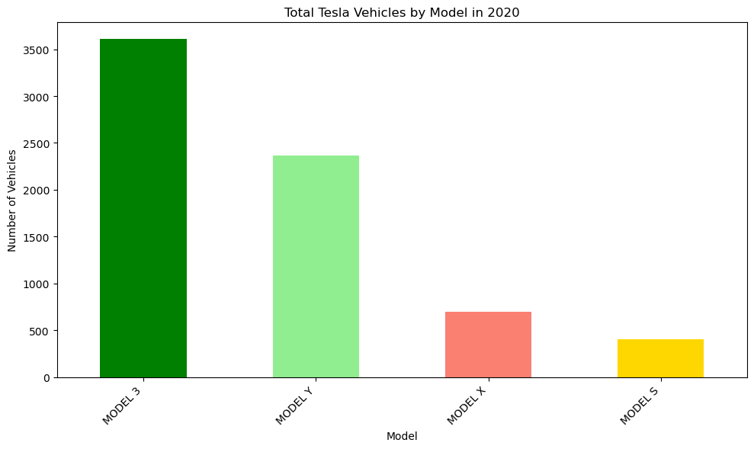
9)Total Tesla Vehicles by Model in 2020
Conclusion:
Model 3 had the highest sales, with 3,607 vehicles sold, indicating its popularity among consumers.
Model Y followed closely behind with 2,369 units sold, reflecting its growing demand since its introduction.
Model X and Model S had lower sales compared to Model 3 and Model Y, with 694 and 407 units sold, respectively.

Slide 14
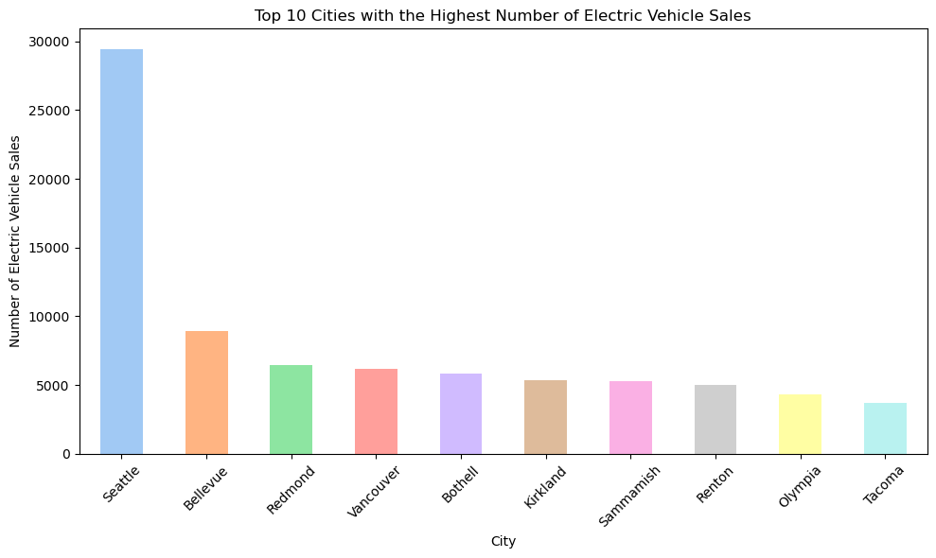
10)Top 10 Cities with the Highest Number of Electric Vehicle Sales
Conclusion:
Seattle leads by a significant margin in electric vehicle sales, indicating strong adoption and infrastructure support for EVs.
Other cities in the top 10 also show considerable EV adoption, with Bellevue, Redmond, and Vancouver following Seattle closely.
Smaller cities like Olympia and Tacoma also contribute to the overall EV sales, showcasing a distributed pattern of adoption across the region.

Slide 15
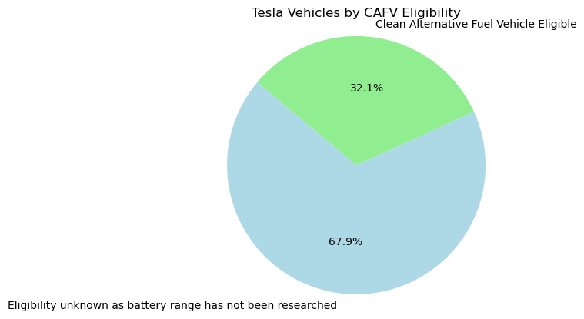
11)What is the distribution of Clean Alternative Fuel Vehicle (CAFV) eligibility among Tesla vehicles?
Conclusion:
A significant portion of Tesla vehicles (53,969) have unknown CAFV eligibility status due to unexplored battery range research.
However, a considerable number of Tesla vehicles (25,502) are eligible for Clean Alternative Fuel

Slide 16
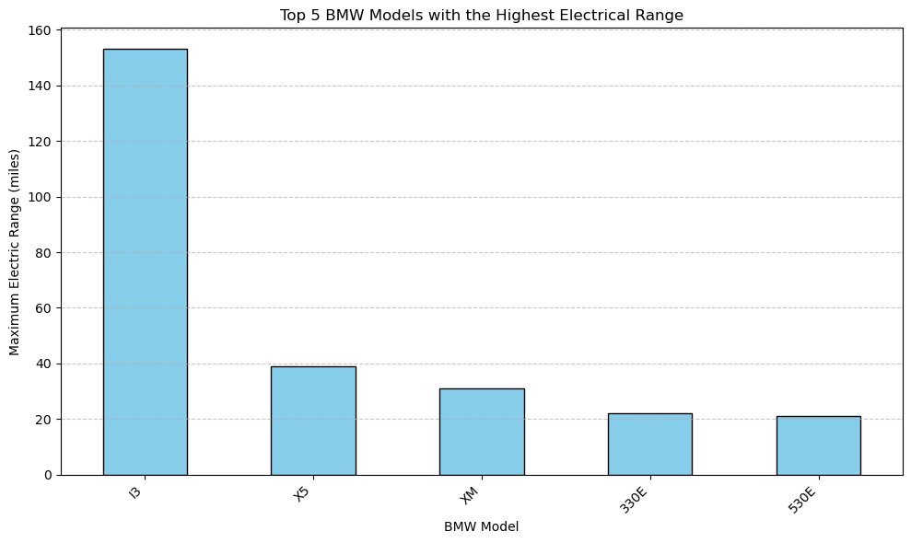
12)top 5 BMW models with the highest electrical range
Conclusion:
The i3 model from BMW leads by a significant margin with an electrical range of 153.
Other BMW models such as X5, XM, 330e, and 530e also offer notable electrical ranges, indicating BMW's commitment to providing diverse electric vehicle options with competitive ranges.

Slide 17
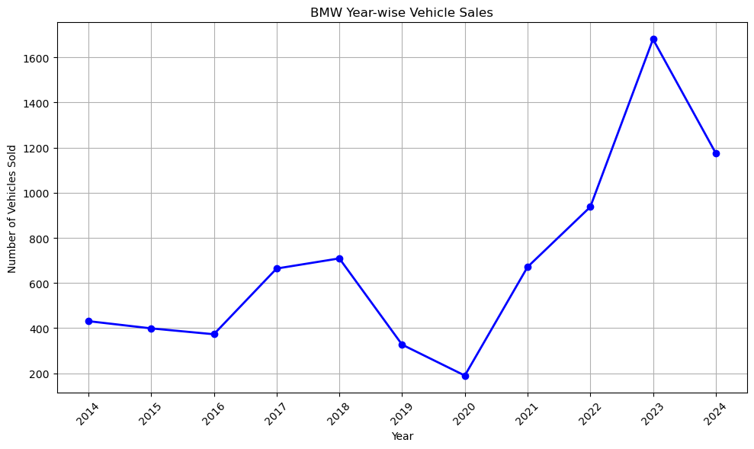
13)Analyze BMW's year-wise sales
Conclusion:
2023 marks the peak year for BMW sales with 1680 units sold.
Following closely behind is 2024 with 1175 units sold, suggesting sustained high sales volumes.
2019 and 2020 experienced relatively lower sales volumes with 327 and 190 units sold, respectively.

Slide 18
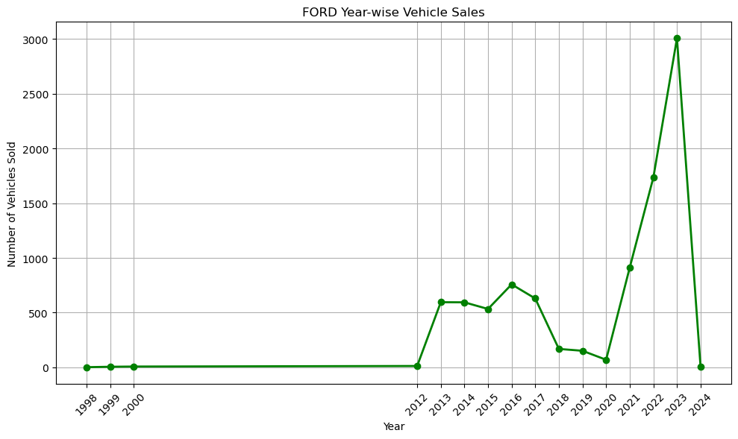
14)Analyze FORD's year-wise sales
Conclusion:
There is a notable increase in Ford sales starting from 2013, with a peak in 2023.
Prior to 2013, sales volumes were relatively low.
However, there is a slight dip in sales in 2024
Overall, the data suggests a positive trend in Ford's sales performance over the years, particularly with a remarkable surge in 2023.

Slide 19
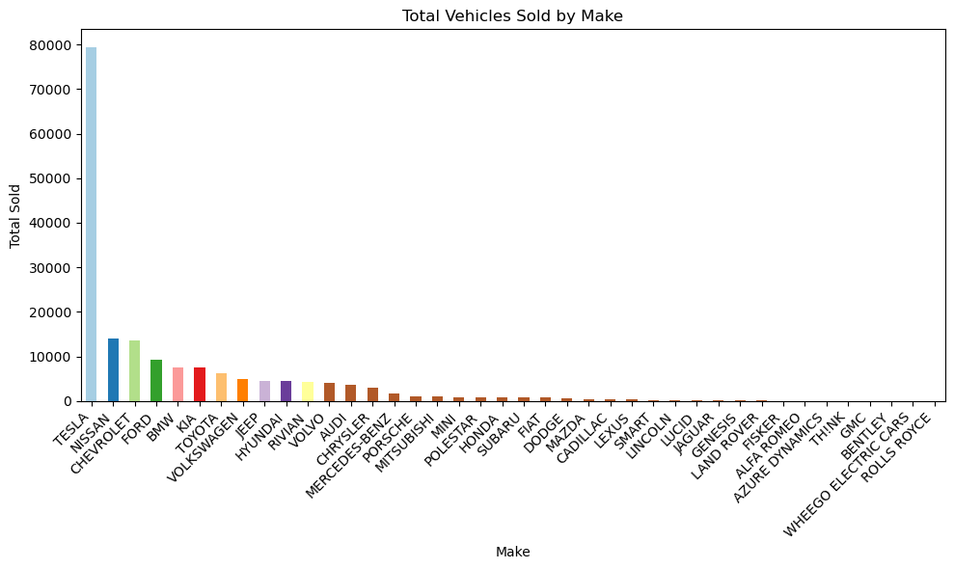
15)calculate total vehicle sold by make

Slide 20
Conclusion:
Tesla leads with the highest number of vehicles sold, followed by Nissan and Chevrolet.
Luxury car manufacturers like Porsche, Bentley, and Rolls Royce have lower sales volumes compared to mainstream brands.

Slide 21
Thank You

